Slide 1

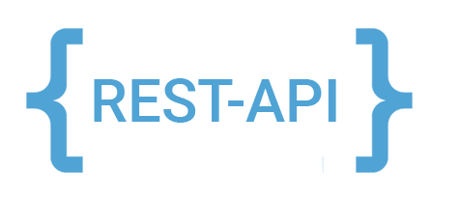
Application frameworks
REST services & KoaJS

Slide 2
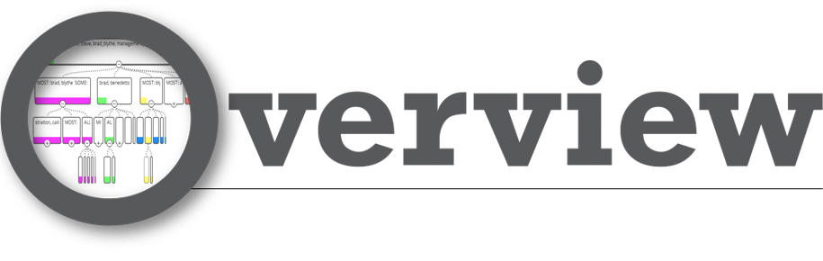
REST
HTTP messages
HTTP verbs
Six Constraints
Compliance
Best practices
HTTP codes
Koa JS
Let’s do coding

Slide 3
RESTful services
REpresentational State Transfer protocol.
Built around things or resources - Resource based.
Nouns vs actions. REST services are not action based though HTTP verbs being used to perform different operations on the same resource.
Resource are identified by a URI.
Multiple URIs may refer the same resource.
Client and server communication.
JSON or XML is used to pass data.
Lightweight, scalable and maintainable.

Slide 4
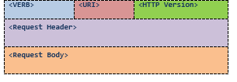
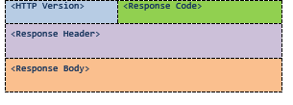
HTTP messages

Slide 5
HTTP Verbs
Verb | Operation | Safe
GET | Fetch a resource | Yes
POST | Insert new resource | -
PUT | Replace existing resource | Idempotent
PATCH | Update Resource | Idempotent
DELETE | Remove a resource | No
OPTIONS | Get all allowed options | Yes
HEAD | Get only the response header | Yes

Slide 6
6 Constraints
Uniform interface
Stateless
Cacheable
Client-Server
Layered System

Slide 7
Uniform interface
Based on the HTTP specification.
URIs refers to resources and HTTP verbs are actions performed on resources.
HTTP verbs (GET, PUT, POST, DELETE).
URIs (resource).
HTTP request (header, body, query parameters and URI) and response (header/status and body).
Use hypermedia to better navigation through resources (HATEOAS - Hypermedia As The Engine Of Application State). Use links for retrieval of related resources.

Slide 8
Stateless
No client state on the server.
Self containing messages. Each message contains sufficient information for that particular operation.
Session state will be kept in client side.

Slide 9
Client-Server
Use URI to make the connection between two.
Clearly separates user interface and services. Client is portable, client does not have any connection to data server. Server stand independent from different user interfaces.
HTTP stack is the communication platform.

Slide 10
Cacheable
REST services should be cashable.
Resources returned from the server should be cashable.
Client can cache resources (implicit caching).
Server determines what and how should be cached (explicit caching).
Server-Client negotiate the caching scheme.

Slide 11
Layered System
Client does not sees the underlying layers or complexities of the service.
Client only knows the URI.
Server is decoupled enough to have multiple layers and intermediate services sitting in between client and server.
Client only deals with the abstraction of resource URI and verb.
Highly scalable.

Slide 12
Code on demand
Optional constraint.
Server has the luxury to transfer some part of the logic to the client.
JS is being passed to client to execute.

Slide 13
Compliance with REST constraints
Performance
Scalability
Simplicity - Uniform interface
Modifiability - Change components while running
Visibility - Communication between agents
Portability - Components, by moving program code with data
Reliability

Slide 14
Best practices
Nouns over verbs.
Do not use GET method to alter the state.
Use plural nouns.
Represent subresources.
Use HTTP status codes for errors.
Use links to other related resource where needed.
Provide additional functionalities like filtering, pagination, sorting and field selection via query parameters.
Version the api.
Always expose via HTTPS.

Slide 15
HTTP codes
200 - OK *
201 - Created *
202 - Accepted
204 - No content *
301 - Moved permanently
302 - Found
304 - Not modified *
400 - Bad request *
401 - Unauthorized *
403 - Forbidden *
404 - Not found *

Slide 16
HTTP codes
405 - Method not allowed
409 - Conflict *
412 - Precondition failed
500 - Internal server error *
502 - Bad gateway
503 - Service unavailable

Slide 17
Koa JS
Node JS web application framework.
Designed for developing web applications and APIs.
Minimal features but many features available via plugins.
Robust routing.
High performance.
Test coverage.
Extensible.
Reusable.

Slide 18
Let’s do some coding
Serve html file using Koa JS.
Create REST API using Koa JS.
Persist resources in Mongodb.

Slide 19
References
http://www.restapitutorial.com/lessons/whatisrest.html#
https://restfulapi.net/
https://martinfowler.com/articles/richardsonMaturityModel.html
https://en.wikipedia.org/wiki/Representational_state_transfer
https://developer.paypal.com/docs/api/
https://koajs.com/
https://github.com/koajs/bodyparser
https://github.com/koajs/router

Slide 20


